Slide 1



Whole Foods Market in the Philippines
Strategy Plan
MBA 6303-02
Aakash Nemakal, Gohar Dar,
Kyle Kao, Maame Yaa Kesewaa,
Matthew Marsh, Neelan Jayakumar & Shirley Suki

Slide 2
Agenda
01
02
03
Executive Summary
Situation
Analysis
Market Analysis
Overview of strategy plan
Business Description, Marketplace in Philippines & Competitors
Target market, SWOT, PESTEL & Hofstede Analysis
04
05
06
07
Promotional Strategy
Analyzing Budget
Measuring Effectiveness
Drawing Conclusions
Marketing objectives, Analyzing 4Ps, Examples
Resources available, budgeting approach & allocation
Utilizing Key Performance Indicators (KPIs)
Recap of strategy plan

Slide 3
Executive Summary
Whole Foods is an innovative brand that has potential to expand into the Philippines. With success in the U.S., this company can implement marketing strategies that attract Filipino customers and establish their place abroad in the natural and organic food industry. An analysis of the marketplace, competitors, budget & promotional strategies can help provide Whole Foods with the necessary information it needs to become a success story in the Philippines.

Slide 4
Business Description
Purpose : Natural and organic food supermarket that believes in sustainable agriculture
Founded : 1978 by John Mackey,Renee Hardy-Lawson, Mark Skiles, Craig Weller
Headquarters : Austin, Texas
Company Sale: Amazon bought the grocer for $13.7 billion in 2017
Revenue : $ billion net sales (2021)
Stores : 500+ in US, UK & Canada
Brand Identity: Modern, Quality, Organic
Sales : 21,537,080
Mission Statement : Our purpose is to nourish people and the planet
Why WholeFoods? Core values, vision and strategy fit the Filipino Market
Notes:
Brand Identity : Modern, Quality, Organic feel. Uses green to communicate nature and quality
Core Values :
Selling Highest Quality Natural and Organic Foods
Practicing win-win partnerships with our suppliers
Satisfying and delighting our customers
Promoting team member growth and happiness
Creating profits and prosperity
Caring about our Community and the Environment

Slide 5





Marketing Mix
Product
Place
Natural & Organic products
365 Everyday Value
Whole Foods Market
Engine 2 Plant-Strong
Over 500 stores across US, UK & Canada
Operates digitally as subsidiary of Amazon
Sit down bars & taprooms
Price
Promotion
Premium pricing strategy
with high quality standard
products
Advertisements
Public Relations
Social Media
Sales Promotions
Notes:
Product : variety selection of natural and organic products includes:
produce, grocery, meat and poultry, seafood, bakery, prepared foods, coffee and tea, beer and
wine, cheese, nutritional supplements, vitamins, body care, pet foods and household goods.
Main products :365 Everyday Value : price conscious buyers
Whole Foods Market brand : premium products
Engine 2 Plant-Strong : vegetarian and special dietary preferences
Price : Premium pricing strategy coupled with high quality standards to prove to customers their products are worth buying.
Also affirms the sustainability assurance offered by the company.
Promo : Advertisements : Dependent on season and industry conditions. Uses an affective strategy to connect happiness with good health.
In this campaign, Global executive director said the goal was to give the effect of living well when you’re at WF.
You’re living an overall balanced, healthy life. Heavy on Imagery, light on text but text must be impactful.
PR: Engages in community programs. Shop local, Give local initiative.
Each dollar donated helps provide at least 10 meals* to neighbors facing hunger.
Whole Planet Foundation, Whole Kids Foundation, Whole Cities Foundation
Sales Promotions: Offers discounts as a way of sales promotions.
Social Media : Making client/ consumer brand ambassador by sharing User Generated Content on
social media.

Slide 6
Market Analysis - Why the Philippines?
Strengths
Weaknesses
High brand recognition
High quality standards
Innovation
Dependent on American Market
Consumer Perceptions
Frequent Strikes

Slide 7
Market Analysis - Why the Philippines?
Revenue in the Filipino food market amounts to US$121 bn in 2022. The market is expected to grow annually by 7.89% (CAGR 2022-2027)
As of 2021, the total retail sales value of packaged foods amounted to about $16.24 billion
Economic growth has resulted in increased urbanization, a growing middle class, & large young
population, creating a strong consumer market in the food & grocery industry.
Consumers in the Philippines spend the most in the area of "Food & non-alcoholic beverages"
Food consumption habits have changed post Covid as consumers are switching to healthier
lifestyles
Agricultural country so Whole Foods can leverage natural resources as supply
Filipinos love Western products
Food is an important part of Filipino culture - Food is so important that they greet
each other by saying “Kumain ka na?” -- Have you eaten? – to greet one another.

Slide 8
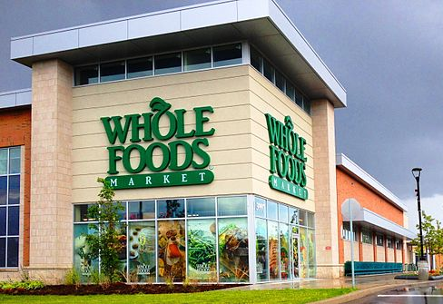
Market Analysis - Entry Method
The best method for entering the Filipino market will be through franchising although Whole Foods is not a franchise in the US, UK or Canada
But since they have never entered the Asian market, a franchising model will be effective to reduce risks and liabilities, speed up the growth and expansion process, and target customers easily and effectively.

Slide 9
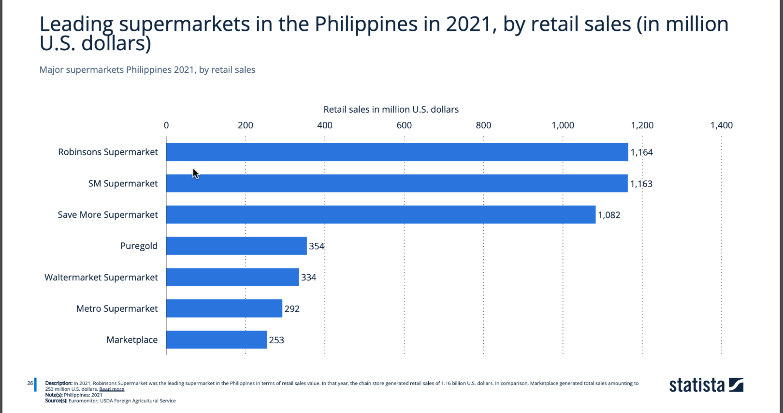
Competitors

Slide 10
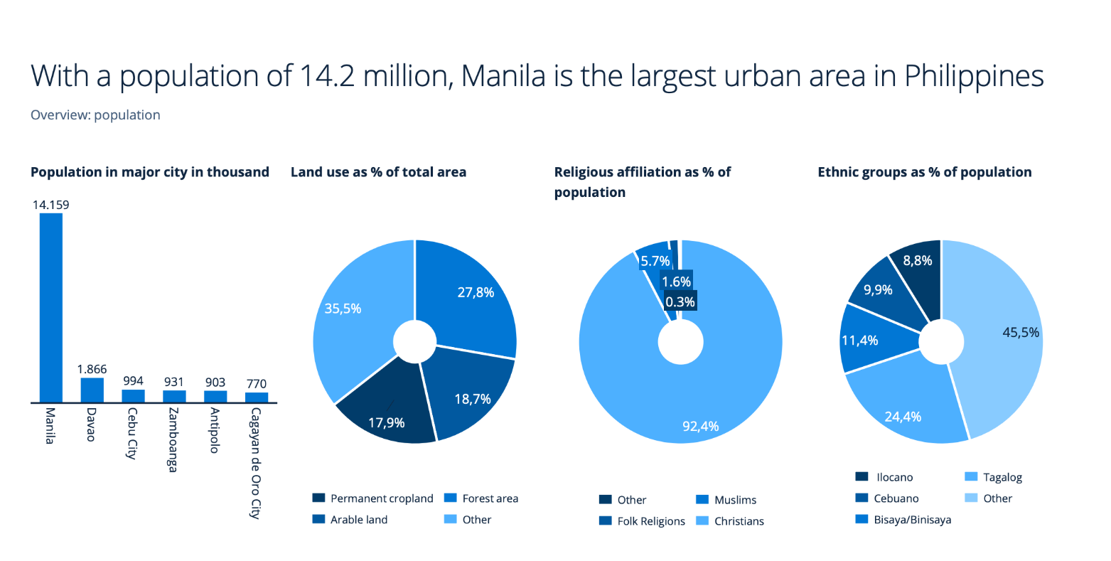
Expanding Whole Foods in Manila, Philippines

Slide 11
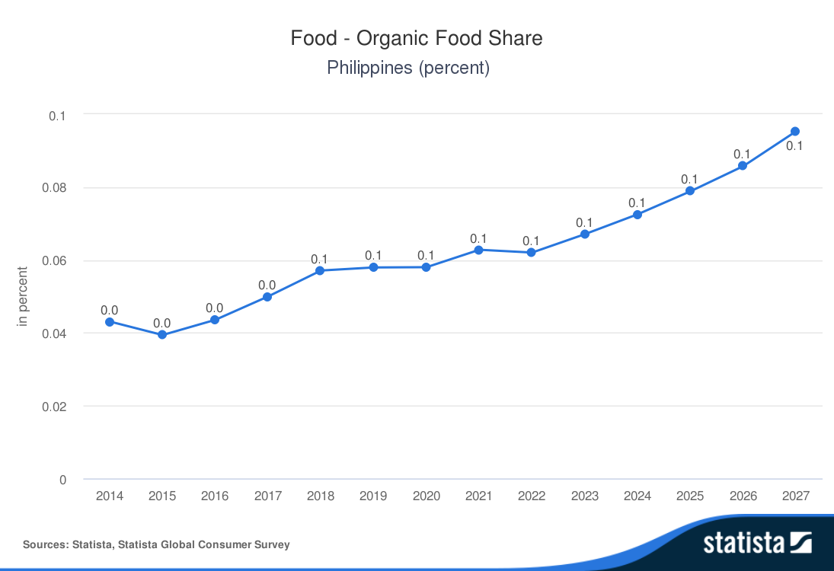
Organic Food Share

Slide 12
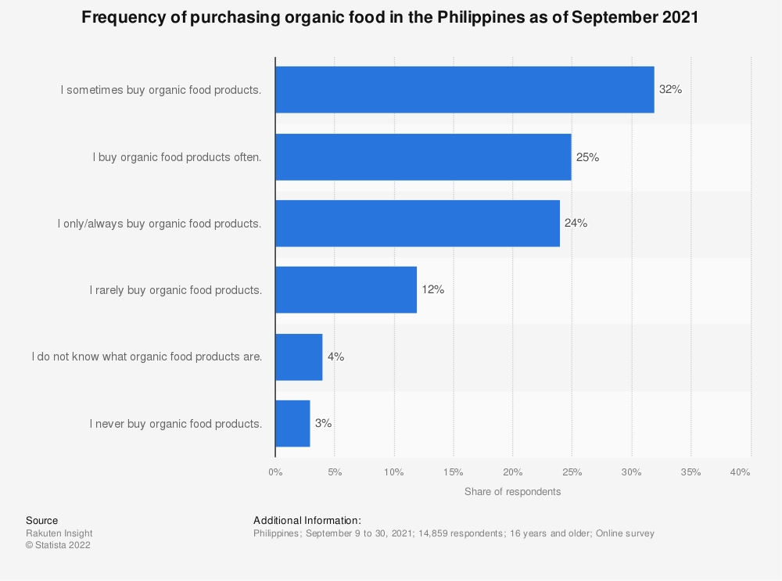
Organic Food Purchasing Habits

Slide 13
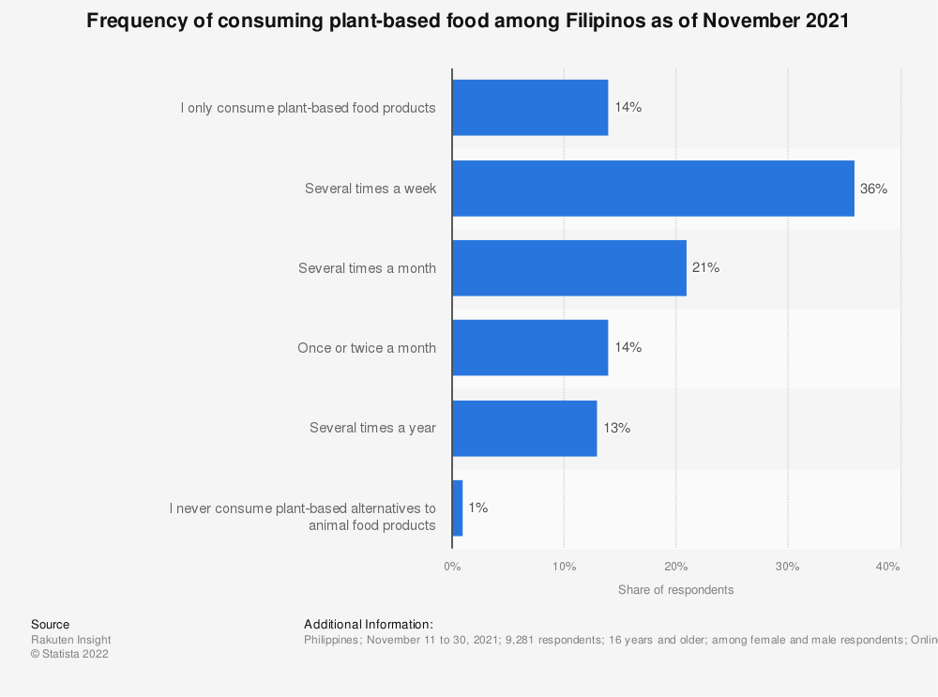
Plant-based Food Consumption Habits

Slide 14
Target Market Analysis
Behavioral
Demographic
Convenient
Product variety
Food safety and quality
Ages 25-50
Middle-high level incomes
Educated professionals
Health conscious
Psychographic
Geographic
Attracted to western lifestyle influence
Eat healthy & seek natural & organic products
Supermarket
Convenient store

Slide 15
SWOT Analysis - Food & Beverage Retail in Philippines
Strengths
Opportunities
The soft drinks & alcohol markets are hugely profitable
Effectively localized
O
Increasing investment with easing of FDI restrictions in foreign retailers
Increasing consumption levels
Western influences are strong
The 'healthification' trend in youth population
S
T
Weaknesses
Structural problems
Low per capita incomes & unemployment levels
Underdeveloped distribution infrastructure
The OECD has criticism
Threats
W
Competition from other ASEAN markets
Elevated CPI is expected over Q 1,2,3 of 2023
Slow development of mass grocery retail in rural areas
Negative impact of the proposed increase of the sugar tax on the drink industry
Notes:
For the Food and beverage retail industry in Philippines limited domestic input, inefficient post-harvest and storage facilities, and inadequate distribution links.

Slide 16
PESTEL Analysis - Philippines
Economic
Technological
Legal
GDP is forecasted to increase by 7.4% from 2021-2026; High concerns about poverty.
E-commerce is booming
The easing of investment restrictions on foreign retailers in early 2022
E
T
L
P
S
E
Political
Sociological
Environmental
High risk of political instability and/or politically-motivated violence
110 M in 2021, estimate 119 M in 2027; High level of English proficiency
34th highest carbon dioxide emissions in 2020; very high recurrence of extreme weather events

Slide 17
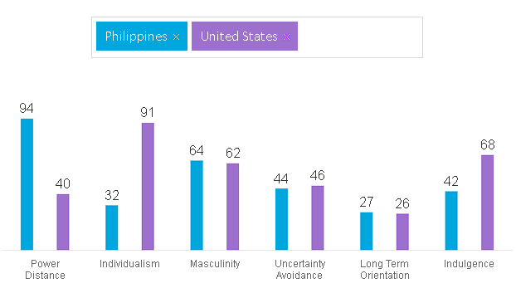
Hofstede Analysis
Notes:
For the Hofstede Analysis,
Power distance are high while individualism and indulgence are lower
people accept a hierarchical order in which everybody has a place and which needs no further justification.
individualism,collectivistic society
have a tendency to cynicism and pessimism

Slide 18
STP Analysis
Strategy
Targeting
Positioning
Natural and organic foods supermarkets
A variety selection of natural and organic products
Top natural and organic foods supermarkets with American import goods
Attracted by western lifestyle influence
Healthification trend

Slide 19
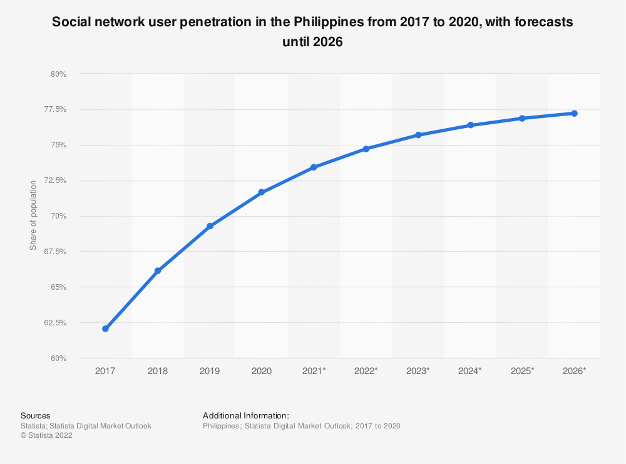
Promotional Strategy
Large portion of the population is active on social media
Build brand awareness to the local population
Sell both local and imported products
Notes:
Educate consumer

Slide 20
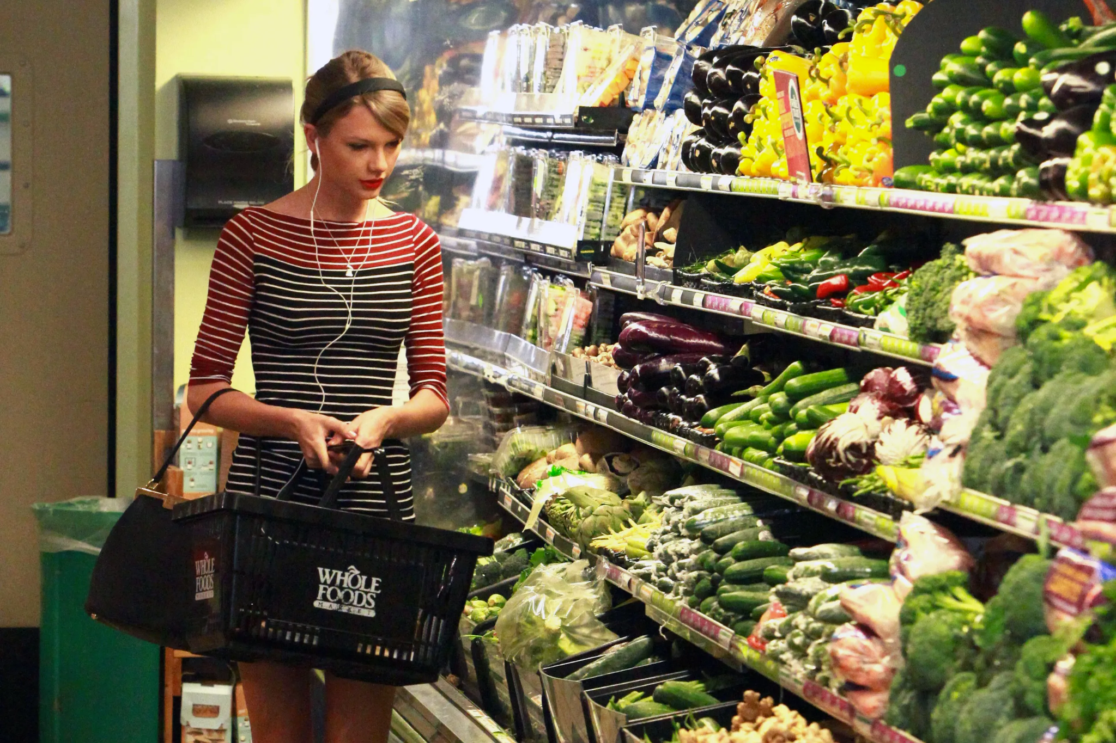
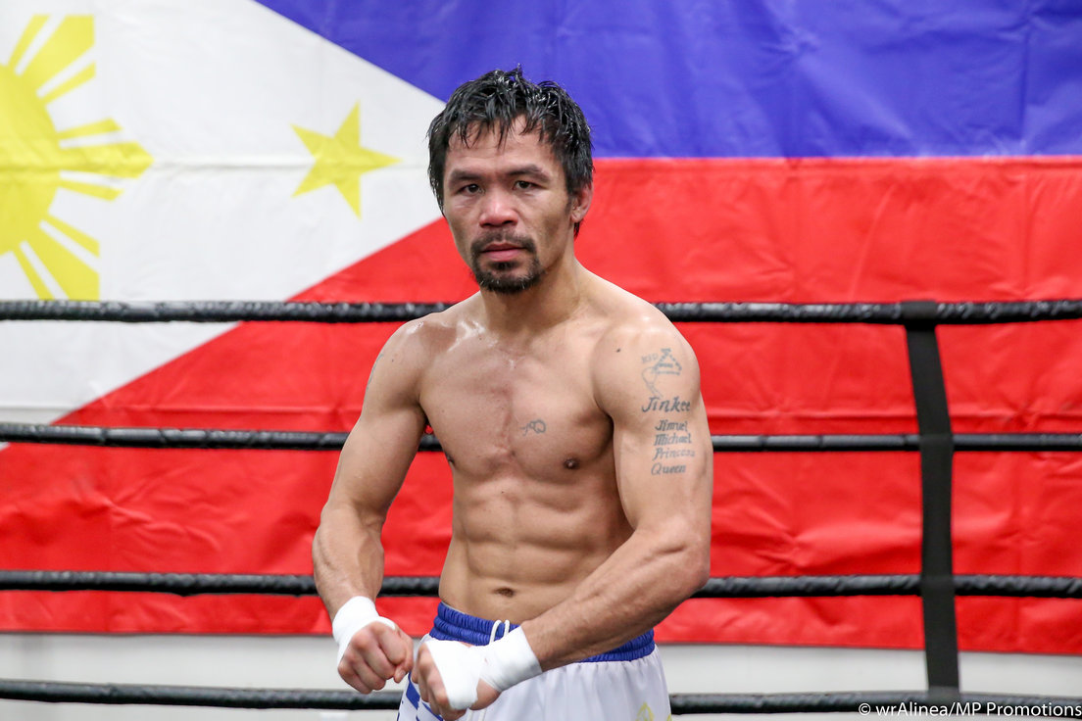
Promotional Strategy
Social media advertisements
Commercials that provide both entertainment and information
Celebrities and social media influencers
Notes:
Robinsons supermarket has very informative advertisements
International Trade Administration

Slide 21
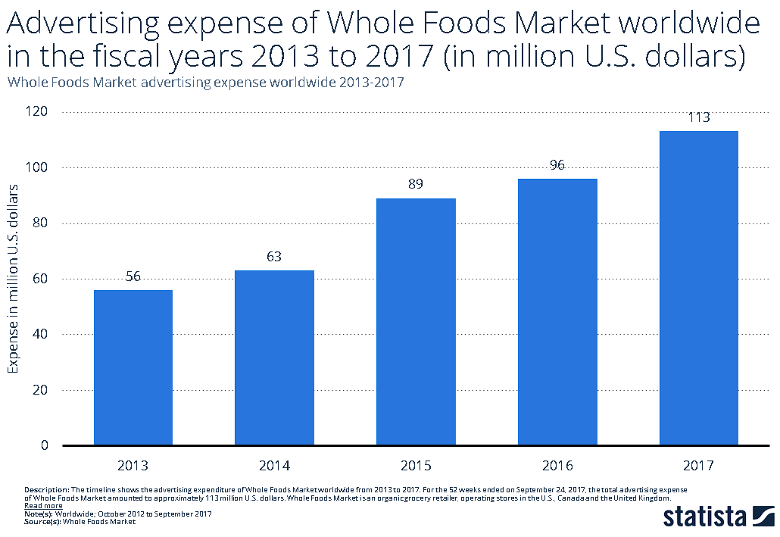
Current Expenditure on Marketing

Slide 22
Budget: $12 Million
In Q2 of 2019, Whole Foods spent about $18 million in advertising worldwide
Whole Foods entering Philippines for the first time, $2 million is a reasonable budget for marketing and advertising
This budget would be spent on advertising on social media, print, television and radio, and partnerships.
Whole Foods will have to run a massive marketing campaign to make the potential consumers aware of its value proposition
Existing players in the market will increase their marketing as well to not lose their market share to whole food.

Slide 23

Budgeting for Marketing for Philippines
Social Media
Print
Whole foods should allocate 40% of its budget to market its business on social media and website ads. It should leverage influencers.
15% of the budget can be spent on advertising via magazines and newspapers.
Partnerships
Media
25% budget for advertising via TV commercials and radio.
20% of the budget should be spent on partnership with existing credible and familiar brands to penetrate the market

Slide 24
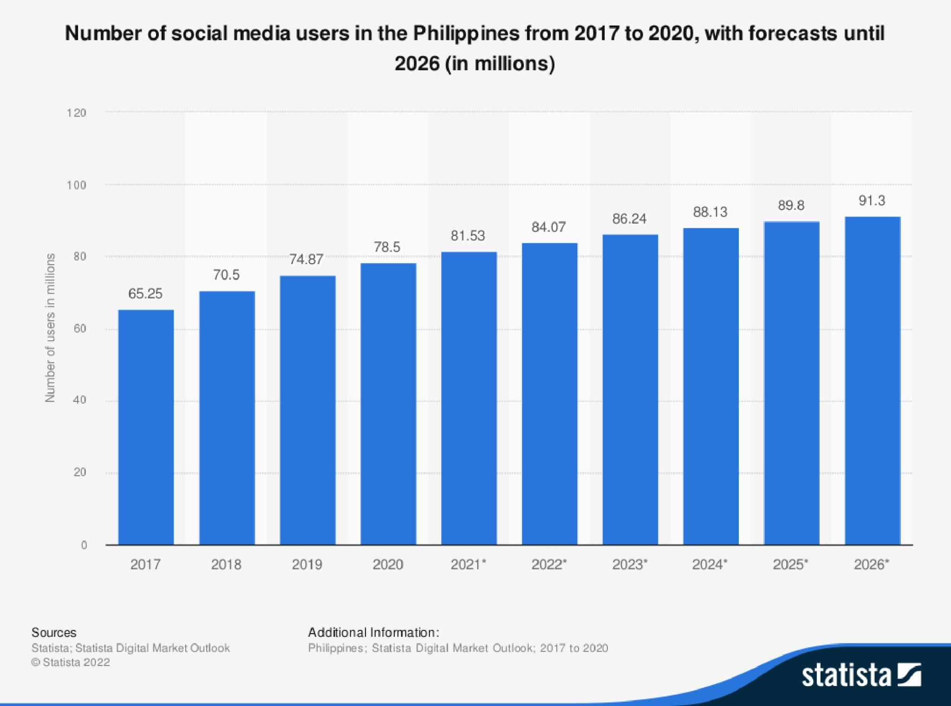
Promotional Mix Strategy
Philippines is considered as the Social Media Capital of the world.
They have over 85 million social media users among a population of 105 million people.
Almost 99% of the people who use social media are on Facebook.
Scheduling: 1pm-3pm on weekdays; 6pm-9pm on weekends
Not using direct marketing

Slide 25

Media Vehicle - Social Media Posts
A lot of users in the Philippines use Facebook along with other famous apps like Instagram and Tiktok
A social media promotion of this sort can be done in order to reach the large number of users that exist in Philippines

Slide 26
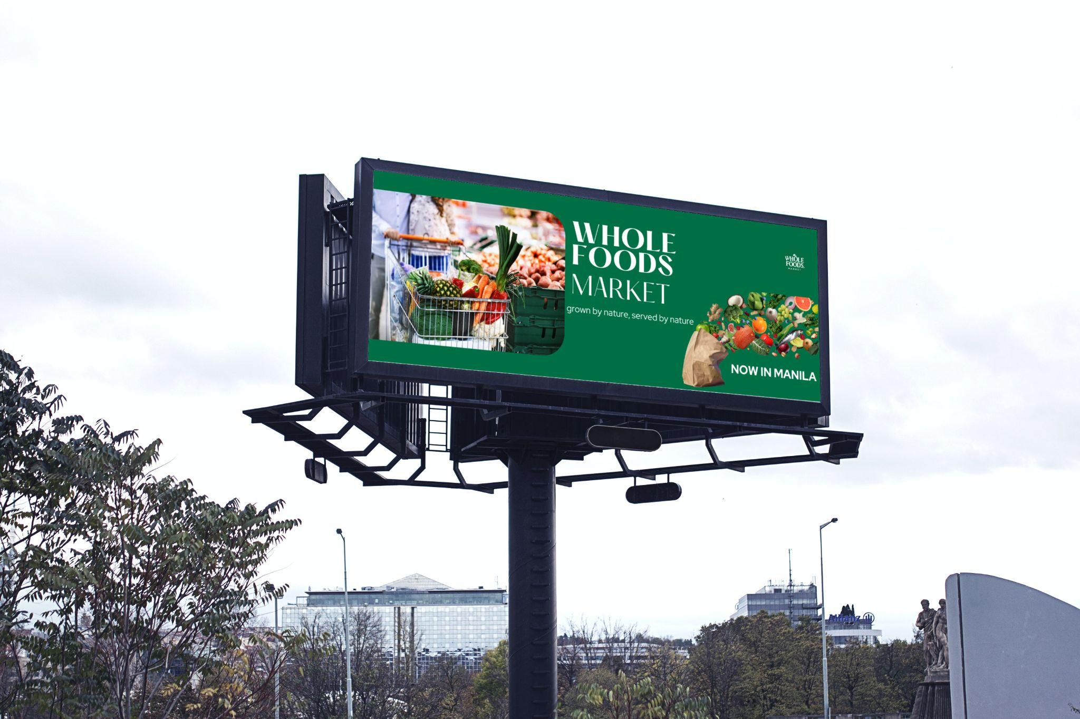
Media Vehicle - Billboard
Traffic is a big problem in Manila. Billboards are efficient in reaching the target audience
Natural appeal to emphasize brand identity
Using images of fruits/ vegetables that are familiar to Filipinos
Tagline : grown by nature, served by nature
Using a couple to represent gender equality

Slide 27
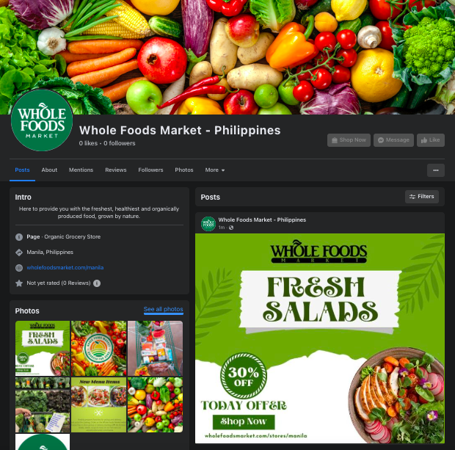
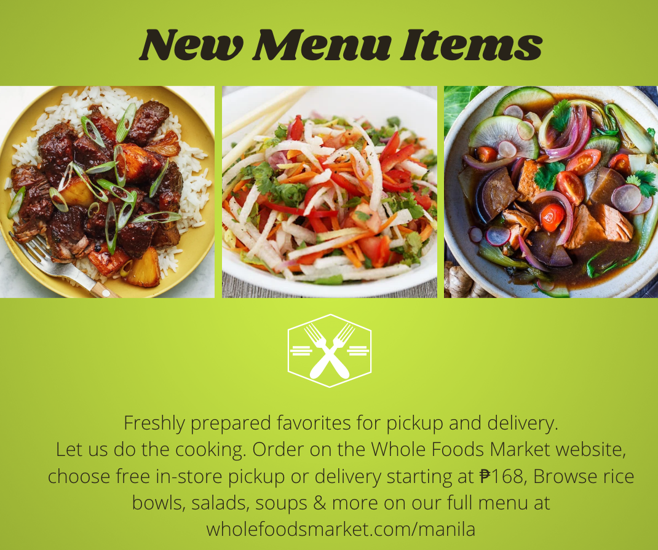
Media Vehicle - Facebook Profile
Adding Filipino favorites such as Adobo to the menu or selling ingredients for dishes that customers enjoy daily can help attract them to Whole Foods

Slide 28
Measuring Effectiveness
Monitoring Key Performance Indicators (KPI’s) such as:
Revenue growth
Profit margin
Return on investment
Client retention rate (users continuing to buy products)
Customer satisfaction
Incorporating customer feedback of the campaign
Click-through rate (on ads/promotional content)
Cost per acquisition (compare ROI from different media vehicles & the cost to acquire a customer)
Related to the company:
Brand awareness & impressions
Brand association
Brand understanding (Do customers know what Whole Foods has to offer?)
Brand preference (over competitors)
Customer Lifetime Value (total amount of money customer is expected to spend on brand’s products)
Other:
Surveys/interviews with focus groups
A/B testing (tests two variants of the marketing campaign & implementing the one that performs better)

Slide 29
Conclusion
Marketing Vehicles
Budget
Social Media
TV Commercials
Total: $12 - 15M
Social Media, Partnerships, Print, Media
Profitable Market
Customer Loyalty
Once the budget is implemented, marketing strategies can take over and allow success for the expansion
Promotional ideas and strategies from a structured analysis that brings new and loyal customers

Slide 30
Thank You!
Any Questions?

Slide 31
Works Cited
Whole Foods Market | Statista (openathens.net) https://www-statista-com.eu1.proxy.openathens.net/study/24462/whole-foods-market-statista-dossier/
Packaged Food Retailing in Philippines: Market Snapshot to 2017 - ProQuest One Business - ProQuest https://www.proquest.com/pq1business/docview/1544532247/B9F7545C0FFD4163PQ/1?accountid=14674
Mergent Online - Company Detail : Whole Foods Market Inc https://www.mergentonline.com/companydetail.php?compnumber=71872&pagetype=synopsis
Compare countries - Hofstede Insights (hofstede-insights.com) https://www.hofstede-insights.com/fi/product/compare-countries/
https://www.ruleranalytics.com/blog/reporting/measure-success-marketing-campaign/
https://latana.com/post/test-brand-marketing/
International Trade Administration https://www.trade.gov/country-commercial-guides/philippines-selling-factors-and-techniques
https://www-statista-com.eu1.proxy.openathens.net/statistics/258673/net-sales-of-whole-foods-market-worldwide/
https://wholefoods.coop/cms/wp-content/uploads/2021/10/Annual-Report-2021-web.pdf

